Slide 1
Spring boot: Adapt to your environment

Slide 2

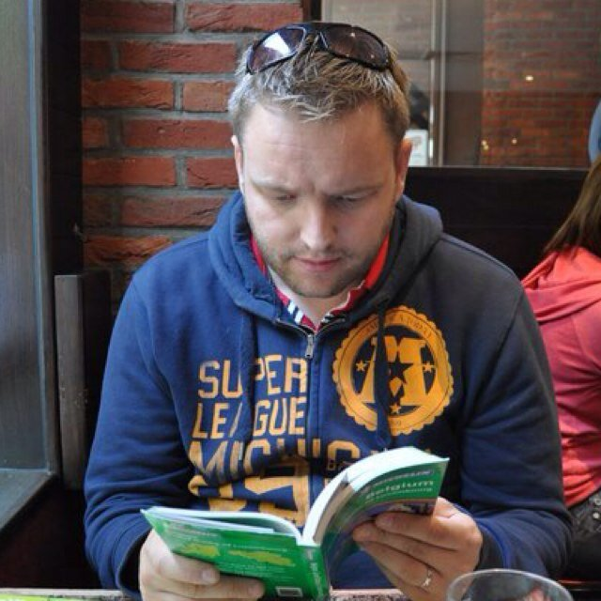
About us
Erwin Hoeckx
Software Architect
CGI
Arjan Jorritsma
Software Architect
CJIB

Slide 3
Content

Slide 4
Acme architecture

Slide 5
Requirements
AcmeMessage needs to be stored, so it can be traced& resent if needed

